Slide 1
Employee Data Analysis using Excel
STUDENT NAME: NAVEEN KUMAR S
REGISTER NO: 122203416
CE63D5EEA9B1A599FA643583C79EA8C3
DEPARTMENT: B.com [CS]
COLLEGE: ST. Thomas college of Arts & Science

Slide 2
PROJECT TITLE
Salary and compensation analysis
Through excel Data modeling

Slide 3


AGENDA
Problem Statement
Project Overview
End Users
Our Solution and Proposition
Dataset Description
Modelling Approach
Results and Discussion
Conclusion
3/21/2024 Annual Review

Slide 4


PROBLEM STATEMENT
Salary and compensation analysis using excel involves evaluating and measuring an
Employee’s salary and compensation based on their pay zone (PZ). This data then analyzed
Using excel’s functions and tools, such as pivot tables, charts, and conditional formatting, to identify
The pay zone areas to be differentiated. The analysis helps in making informed decisions regarding
Salary to be compensated to the employee’s in accordance to pay zone and overall workforce.

Slide 5


PROJECT OVERVIEW
.
The project “Salary and compensation analysis Through excel Data modeling” aims to
Systematically evaluate employee salary and compensation by leveraging excel’s analytical tools.
The project will involve collecting and organizing salary and compensation data such as department
Types, pay zone, division, and attendance records. This data will be processed and analyzed using excel
Functions like pivot tables, charts, and statistical formulas to generate insights into a data to segregate
Salary to be compensated to the respective employee. The outcome will help in identifying the
Pay zone under which the employees is set under their respective pay zone. The final
Deliverable will include a detailed report and visual dashboard for easy interpretation and
Strategic planning.

Slide 6
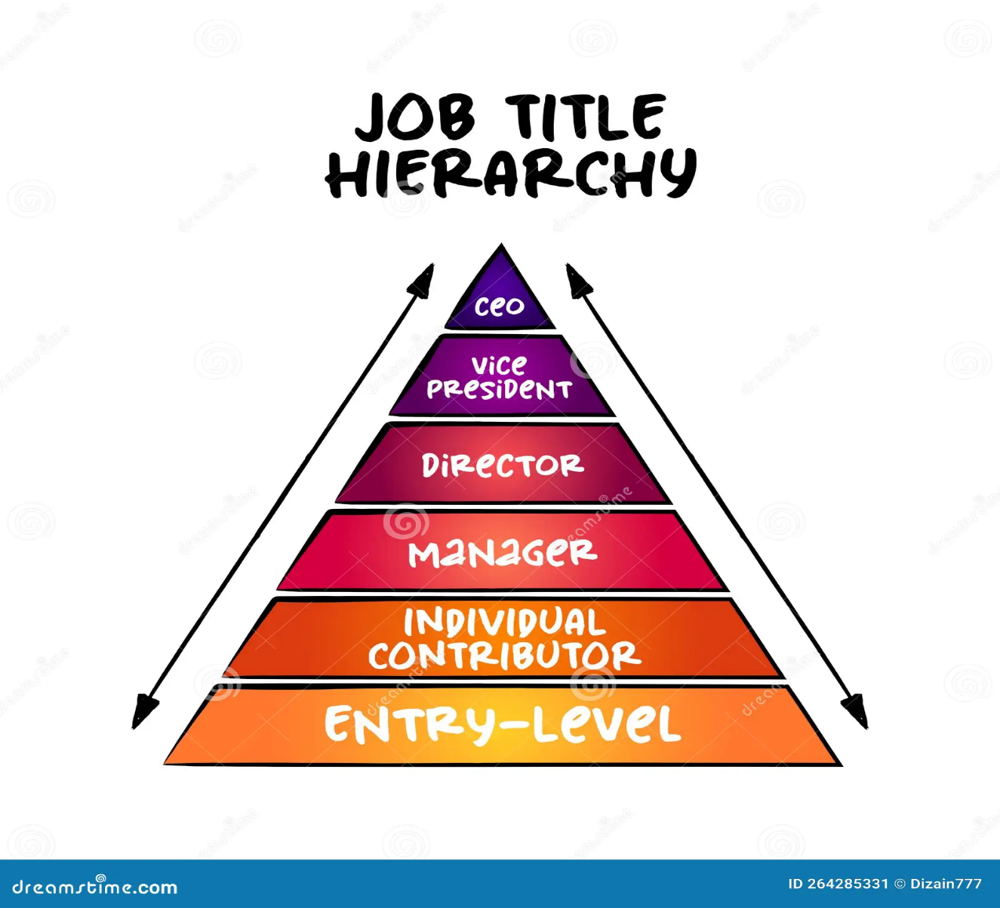

WHO ARE THE END USERS?
Human resource (HR) Managers :
Department Managers/Supervisor :
Senior Management/Executives :
Employees :

Slide 7

OUR SOLUTION AND ITS VALUE PROPOSITION
Data-Driven Insights: Enables managers to make informed decisions based on accurate, real time salary and compensation data.
Improved Efficiency: automates the data collection and analysis process, saving time and reducing manual errors.
Enhanced Employee Development: Identifies training needs and development opportunities, leading to a more skilled workforce.
Better Salary and Compensation: Regularly review and adjust compensation packages, Communicate clearly and transparently Offer flexible and customizable options.
Cost-Effective Solution: Leverages the widely accessible Excel platform, avoiding the need for expensive software or tools.

Slide 8
Dataset Description
Descriptions for each of the columns in the dataset:
Employee ID: Unique identifier for each employee in the organization.
First Name: The first name of the employee.
Last Name: The last name of the employee
Business Unit: The specific business unit or department to which the employees belongs.
Pay zone: The specific pay zone category under which the respective employee is under.
Employee classification type: under what basis the employee works under the company
Department type: under which sub-divided part is the employee part of the company.

Slide 9

THE "WOW" IN OUR SOLUTION
Predictive analytics: Integrating predictive methods to forecast future
salary and compensation based on historical data, giving
managers a proactive Approach to workplace planning.
Automated alerts: the tool can be set up to send automated alerts for
critical salary & compensation issues, ensuring that managers are
immediately notified when attention needed.
3/21/2024 Annual Review
9

Slide 10
MODELLING
In the "Salary and compensation analysis Through excel Data modeling" project, the modelling phase involves setting up the Excel workbook with various tools and techniques to analyse and visualize the data effectively.
Here's how each component will be used:
1. Data Filtering
Purpose: To sort and refine the data to focus on specific criteria, such as department, date range, or individual employee pay zone.
Implementation: Excel's filtering feature will be applied to datasets, allowing users to easily narrow down the data to view only the relevant information. For example, filtering by department or by employee types.
2. Pivot Tables
Purpose: To summarize and analyse large datasets by grouping and aggregating data based on different pay zone metrics.
Implementation: Pivot tables will be used to dynamically calculate and display key business unit (KBUs) such as average task completion time, total hours worked, or percentage of targets met. This will allow users to view performance metrics by different categories, like employee, team, or month.
10

Slide 11
RESULTS
11

Slide 12
conclusion
The "Salary and compensation analysis Through excel Data modeling" project provides a robust and user- friendly solution for evaluating and managing employee salary and compensation. By leveraging Excel's powerful tools such as filtering, pivot tables, charts, and conditional formatting-the project transforms raw salary & compensation data into actionable insights. The resulting interactive dashboards and customizable reports empower managers to make data driven decisions, optimize workforce productivity, and foster continuous improvement across the organization. This solution not only streamlines salary & compensation management but also offers a cost-effective, scalable approach to enhancing overall organizational efficiency.

